Slide 1
Get to know each other.

Slide 2
Greeting
Hello / Hi / Hey
Good morning /afternoon
evening
morning / afternoon/evening

Slide 3
How are you?
Asking | Responding
How are you? How have you been? How are you doing? How's it going? | Fantastic! Very well, thank you. And you? Great, thanks. Good. Fine, thanks. Pretty good. Not bad. OK.

Slide 4
How are you?
Asking | Responding
What's up? What's happening? What's going on? What have you been up to? | Not much. Nothing much. Not a lot.

Slide 5
Farewells
It was a pleasure seeing/meeting you.
It was nice seeing/meeting you.
Goodbye/Bye/Bye-bye.
Good night.
Take care. Have a nice day/evening.
Have a good one. See you (later/soon).
Later. So long.

Slide 6
Questions
Questions | Answers
What is your name? What’s your name? Can I know your name? Please tell your name. May I take your name? Just introduce yourself Hello! I’m Tom and you? | My name is John. I’m John.

Slide 7
Questions
Questions | Answers
Where do you live? | I live on Elm Street. I live at 123 Elm Street. I live in Chapel Hill, North Carolina. I live in the United States.

Slide 8
Questions
Questions | Answers
Where are you from? | I am from England. I'm from England. .

Slide 9
Questions
Questions | Answers
How old are you? Where do you study? What are you study ? | I’m…………………years old. I’m 22. I’m study at……………………… I’m studying …………..

Slide 10
Questions
Questions | Answers
Which year are you in? | I’m in my …………. year at university. first 1/second 2/third3/ final4 I’ve just graduated.

Slide 11
Questions
Questions | Answers
What is your telephone number? Can I have your phone number? *Line Id / facebook /IG | My telephone number is……… Yes you can. It is ………………….

Slide 12
Questions
Questions | Answers
Are you married? | Yes, I am married. No, I am single. No, I am divorced. No, I am widowed.

Slide 13
Questions
Questions | Answers
What is your hobby? What do you do in your free time? | My hobby is …………… I like to +verb …………………. I like to play football. I like +(verb +ing)………….. I like playing football.

Slide 14
Questions
Questions | Answers
What ……. do you like? What is your favorite…….? food / animal/ color/drink | I like ………… My favorite ……… is …………..

Slide 15
Questions
Questions | Answers
What are you good at? | I am good at ……………….. subject ..English /Math Sport ..Football/golf challenge.. singing/ eating

Slide 16
Write about yourself
My name is ……………..
I am ……………years old.
I’m study at ………………….
I’m in ……………year in the university.
I live at ………………
My hobby is …………………….
My favorite food is ………………………
My favorite animal is…………………….
I am good at ………………………………

Slide 17
Please go to ask the new friend.
*Hello
1. What’s your name?
2. Which year are you in
3.How old are you?
Name | Year | old

Slide 18
Please go to ask the new friend.
*Hello
1. What’s your name?
2. Which year are you in
3.How old are you
4. What is your favorite ……….?
Name | Year | old | food | animal | Free time

Slide 19
Entertainment
Movies / film
Sport
Art
Youtube facebook IG
Music/ consert

Slide 20
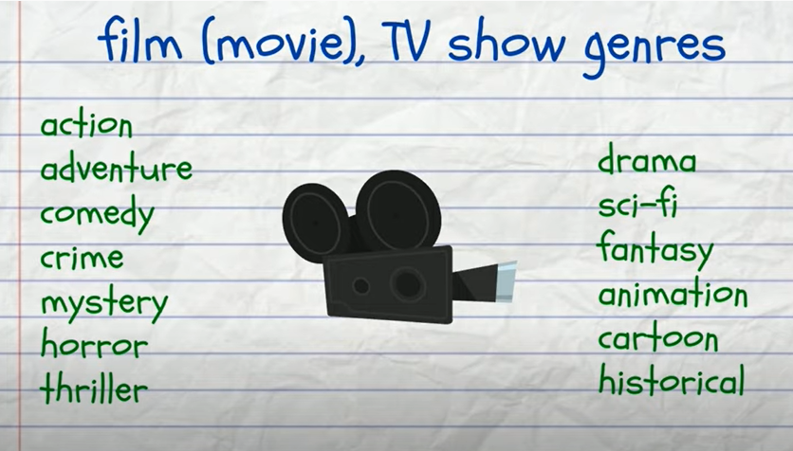

Slide 21
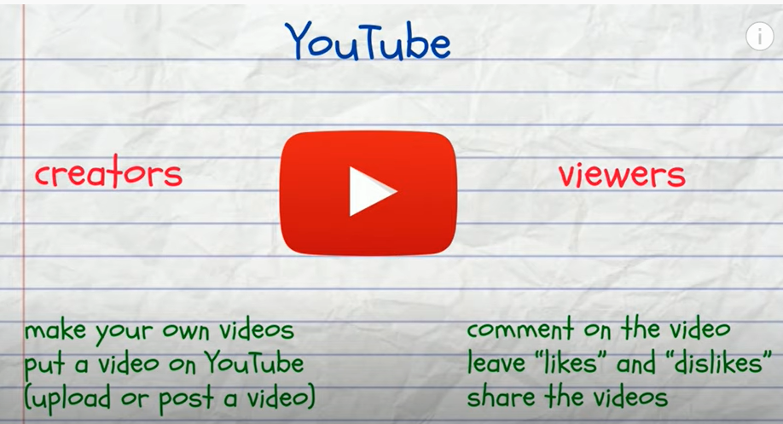

Slide 22
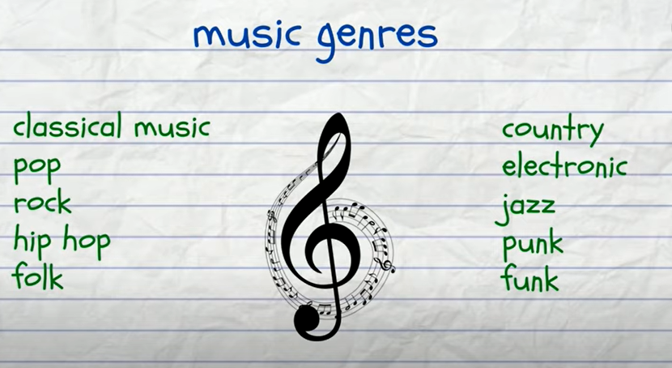

Slide 23
Questions
Questions | Answers
What kind of movies do you like? What is your favorite movies? *Music / YouTube channel Singer / band /artist /you tuber | I like…………… My favorite movies is…………

